Slide 1

Tha sùbh-làir dearg.
Notes:
A strawberry is red.

Slide 2
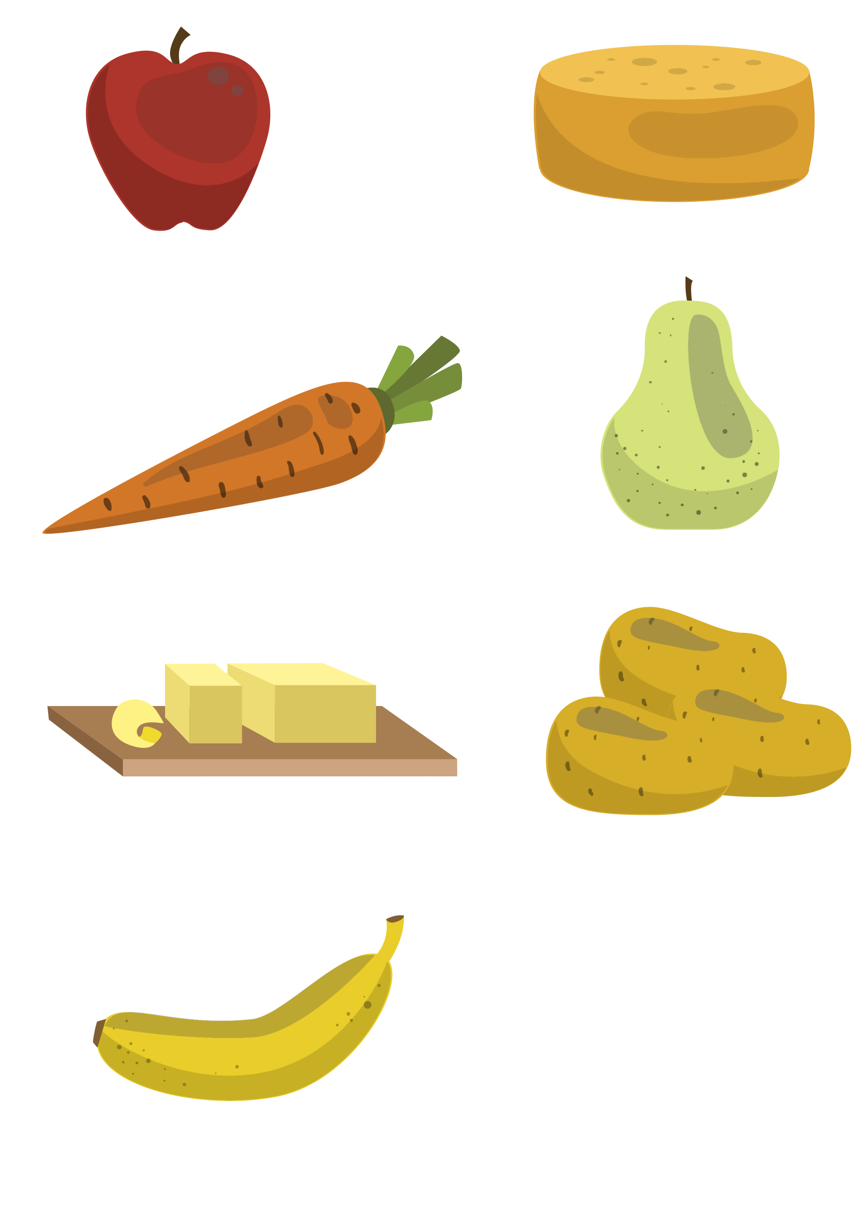
Tha ubhal dearg cuideachd.
Notes:
An apple is red too.

Slide 3
Tha curran orains.
Notes:
A carrot is orange.

Slide 4
Tha càise orains cuideachd.
Notes:
Cheese is orange too.

Slide 5
Tha peur uaine.
Notes:
A pear is green.

Slide 6
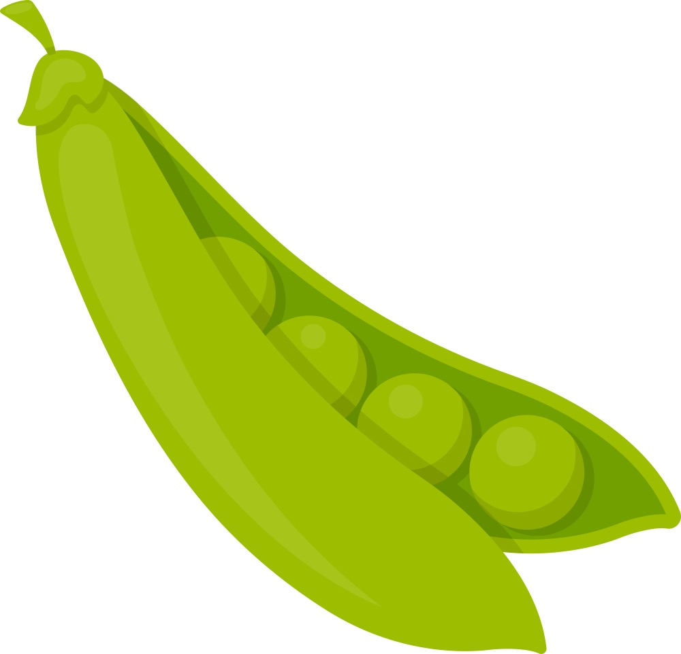
Tha peasraichean uaine cuideachd.
Notes:
Peas are green too.

Slide 7
Tha buntàta donn.
Notes:
Potatoes are brown.

Slide 8
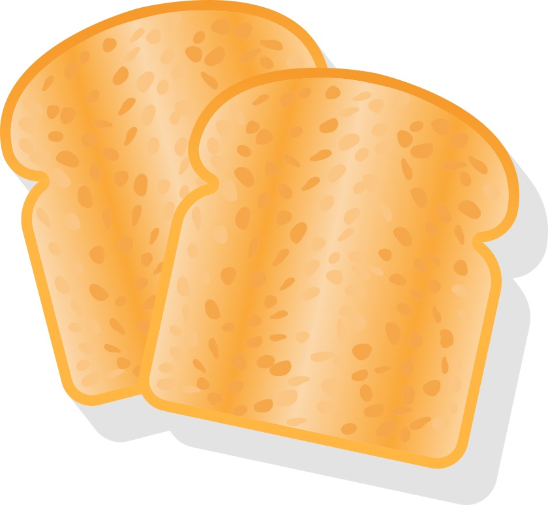
Tha tost donn cuideachd.
Notes:
Toast is brown too.

Slide 9
Tha ìm buidhe.
Notes:
Butter is yellow.

Slide 10
Tha banana buidhe cuideachd.
Notes:
A banana is yellow too.

